Slide 1
Mapping & Navigation Systems Design
By:
Lau Hui Qi, Lau Jun Xiang, Lionel Chew, Ivan Leong

Slide 2
Table of Contents
Objectives
Mapping Algorithm
Grids, x & y coordinates, compass, Multi-move)
Finite State Diagram
Navigation Algorithm
Working
Optimized (Distance)
How we store our data
Problems we face
Running pico (Compiler not so good)
Logic planning (Face a lot logic issues)

Slide 3
Objectives
Map out in a grid of 4 x 5 Grid
Navigate to specific location

Slide 4
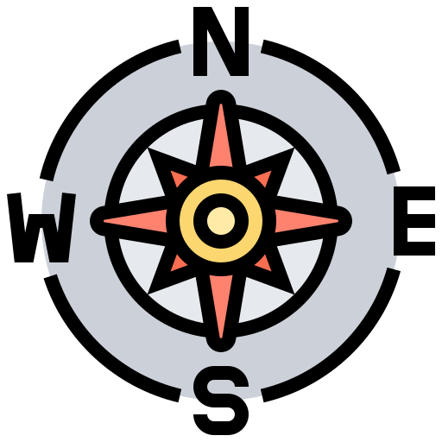

Mapping Algorithm
0
3
1
2
0,1
-1,0
0,0
1,0
Y
0,-1
X
Compass Direction Rule + Turning Calculations (North, South, East and West)
Grid as struct
X & Y Coordinates
Neighboring Grids
Visited
Multi-Move
When there are multiple directions to move and we want to visit them later

Slide 5
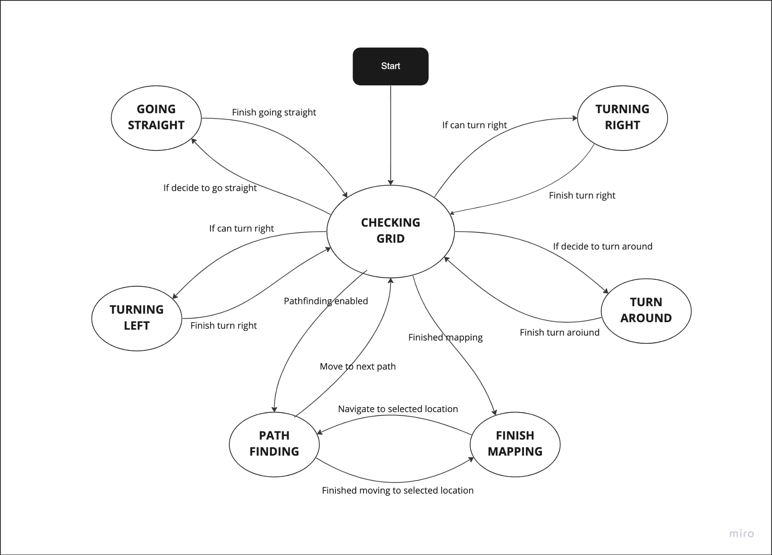
Finite State Diagram

Slide 6
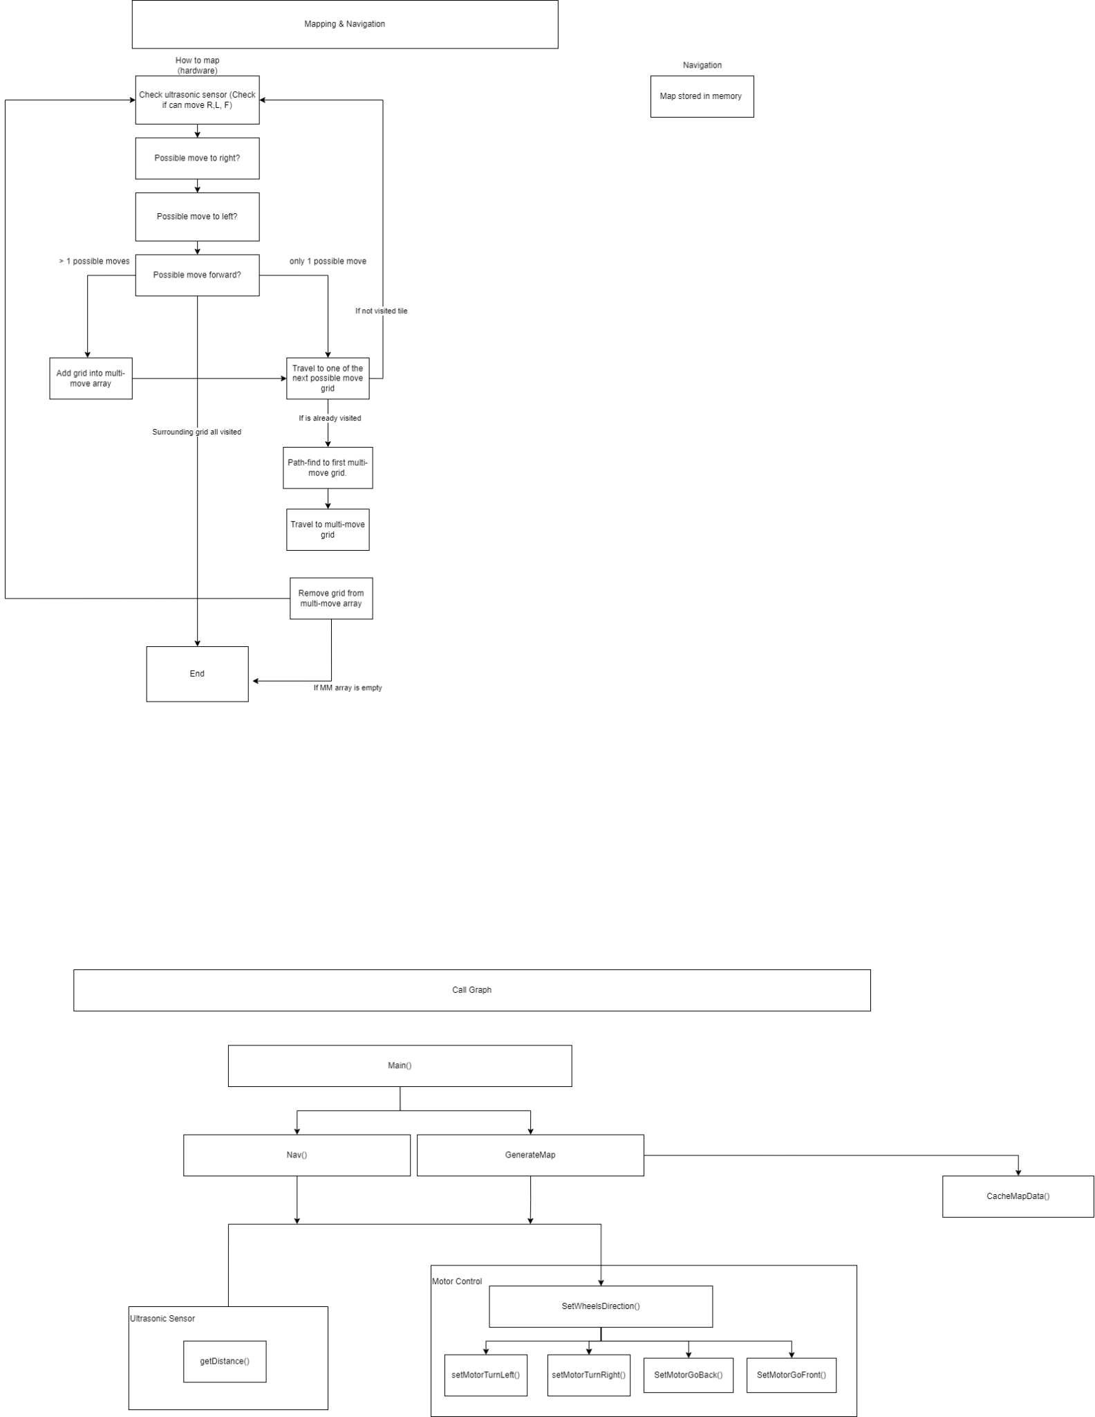
Mapping Algorithm Flowchart

Slide 7
Navigation Algorithm
First working navigation algorithm
Problem: Does not take shortest path.
Optimized navigation algorithm
Solution: Takes shortest path

Slide 8
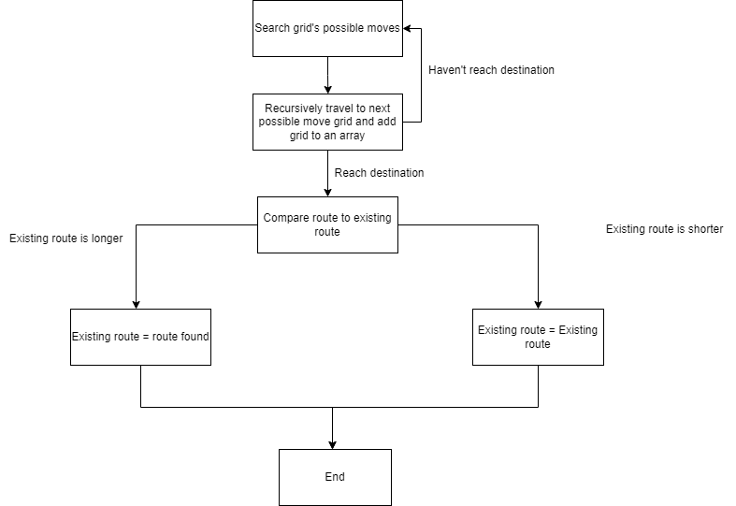
Navigation Algorithm Flowchart

Slide 9
How We Store Our Data
Predefined Array of Grids
MAX size = 30
Each Grid contains:
Short posX, posY (4 bytes)
Grid* neighbour grids [ 4 ] (16 bytes)
Bool visited (1 byte)
Per grid size with padding: 24 bytes
Entire Array size: 30 * 24 = 720 bytes or 0.72KB

Slide 10
Problems We Faced
Pico’s compiles differently from GCC
Receiving keyboard input with Pico
Logic problem with mapping and navigation algorithm
Time crunch

Slide 11
Demo

Slide 12
Thank You

